Slide 1
Encryption for Authentication Factors During Transmission
By: Keziah Rogers

Slide 2
Project Summary & Importance:
Review encryption settings to ensure authentication factors are transmitted securely via HTTPS/TLS.
Encrypting authentication data prevents exposure to attackers and protects data confidentiality.

Slide 3
Tasks:
Access to a secure website or email service that supports HTTPS/TLS encryption.
1. Review the URL to verify HTTPS or TLS is active when logging in to the service.
2. Inspect the SSL/TLS certificate for validity, encryption level, and expiration date.
3. Document your findings and determine if encryption protocols meet PCI DSS standards.
4. Write a report verifying HTTPS/TLS usage and secure transmission of authentication data.

Slide 4
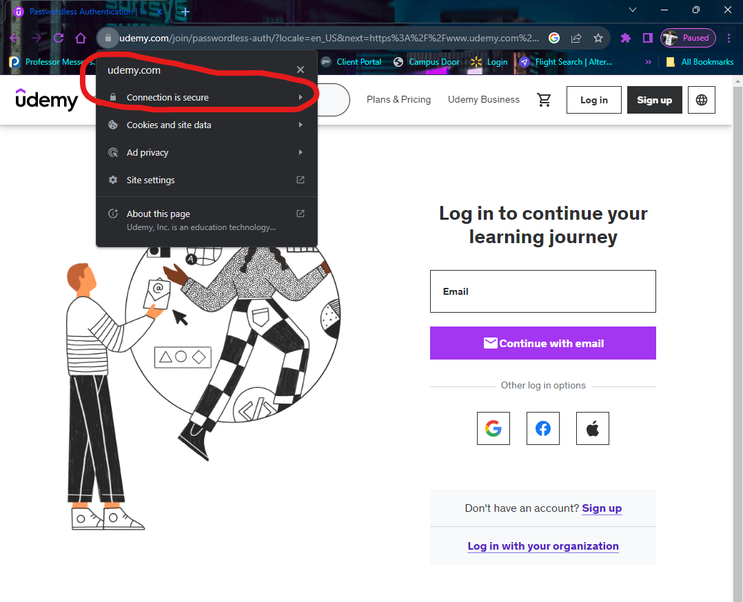
Was authentication data encrypted during transmission?
I reviewed the Udemy website to see if the HTTPS is active when logging into the site. (The site is secure) Yes.
Link: https://www.udemy.com/join/passwordless-auth/?locale=en_US&next=https%3A%2F%2Fwww.udemy.com%2F%3Futm_source%3Dadwords-brand%26utm_medium%3Dudemyads%26utm_campaign%3DBrand-Udemy_la.EN_cc.US_dev%26campaigntype%3DSearch%26portfolio%3DBrandDirect%26language%3DEN%26product%3DCourse%26test%3D%26audience%3DKeyword%26topic%3D%26priority%3DNotSpecified%26utm_content%3Ddeal4584%26utm_term%3D_._ag_137319648178_._ad_634190764968_._kw_udemy_._de_c_._dm__._pl__._ti_kwd-296956216253_._li_9007924_._pd__._%26matchtype%3Db%26gad_source%3D1%26gclid%3DEAIaIQobChMI7sb_qJPRiQMVG0pHAR0q-wQPEAAYASAAEgJqP_D_BwE&response_type=html

Slide 5
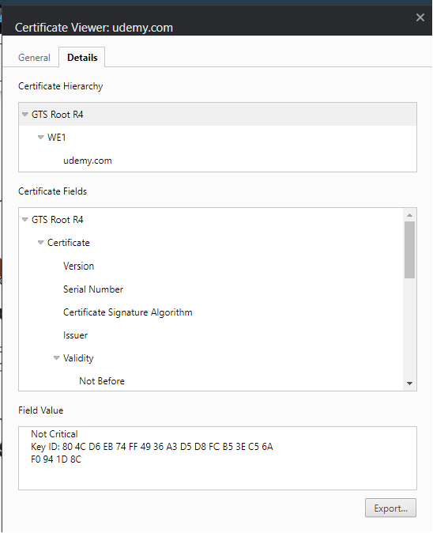
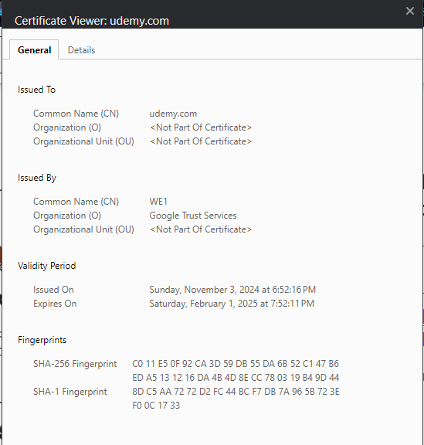
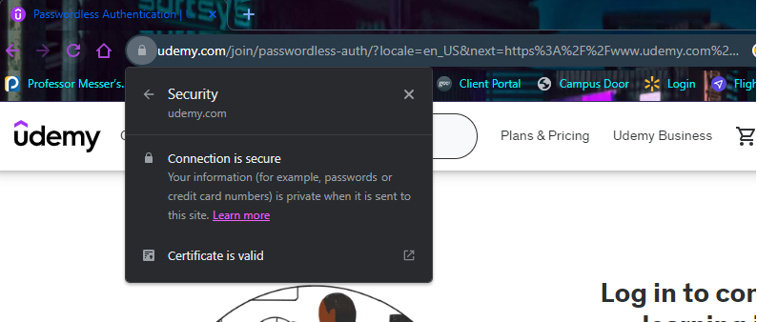
Assess compliance based on encryption:
Yes, this is compliant since HTTPS is encrypted for the Udemy website.

Slide 6
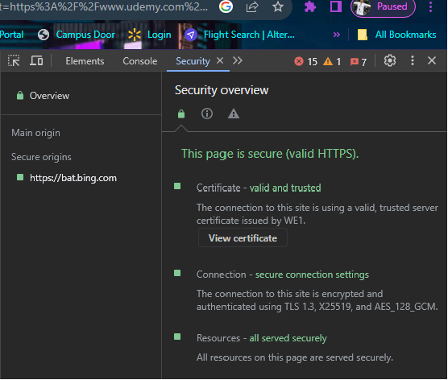
Results:
I noticed that the SSL/TLS certificate for validity (Certificate viewer was issued to udemy.com by WE1/Google Trust Services), encryption level, and expiration date (Issued on November 3rd, 2024, at 6:52:16 PM, and it expires on Saturday, February 1, 2025, at 7:52:11 PM).
I then checked the encryption level by going to the top right of the screen in Chrome, clicking the three dots, selecting more tools, selecting security, and viewing that the encryption is secure through TLS 1.3, X2519, and AES_128_GCM.

Slide 7
Remediation?
There is no recommendation for remediation necessary since the HTTPS follows the encryption guidelines.

